Slide 1
Main beliefs and practices of the Islamic Faith
Discuss

Slide 2
History
The religion Islam was revealed to the Prophet Muhammad in the seventh century CE. The word Islam means ‘submission’ or ‘surrender’; the life of a Muslim is spent, therefore, in willing submission to Allah (Arabic for God.)

Slide 3
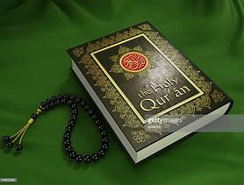
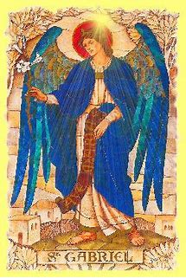
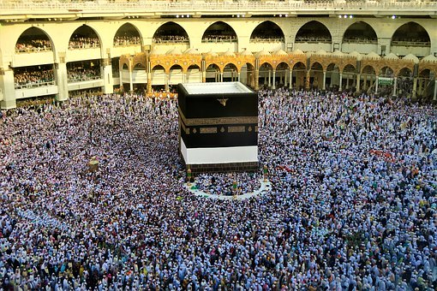
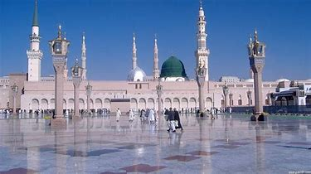
Muhammad

Slide 4
Muhammad
Born 570 in the city of Makkah, where, from the age of 40, he received a series of revelations from Allah.
The revelations were received over a period of 23 years and were delivered by the Angel Jibril (Gabriel)
The revelations form Al-Qu’ran (the Book), the sacred text of Islam.
Muslims do not believe Muhammad brought a new faith. Rather he is seen as the last of along line of prophets sent by God to guide people on to the right path.
Muhammad is regarded by Muslims as the ‘seal of the prophets.’
Muslims offer follow the Prophet’s name with the words ‘peace be upon him’ (pbuh) as a mark of respect.
The Muslim community migrated from Makkah to Medina in 633 Ce (the Hijrah, or migration), a formative event in the history of Islam

Slide 5
The Muslim way: Muslims regard Islam as a complete way of life. There are four main concepts within Islam that underpin all Muslim belief and behaviour.
Tawhid – oneness of Allah
Iman – faith, the believer’s response to God.
Ibadah – same word used for worship and action that is performed with the intention of obeying Allah.
Akhlaq – It means behaviour, morality, manners, attitudes, and the social ethical codes by which Muslims should live.

Slide 6
The five pillars
Shahada – declaration of faith
Salat –ritual of prayer carried out five times a day
Zakat – is an annual gift for charity, usually 2.5 per cent of income
Sawm – fasting for food and water during the daylight hours of the month of Ramadan.
Hajj – pilgrimage to Makkah, to be made at least once in a lifetime if possible.

Slide 7
Other important Islamic concepts
Ihsan – doing what is good, excellent or beautiful. It refers to the right actions, charity, sincerity and goodness.
Jihad – Arabic word that means to struggle, to exert oneself and to strive. Two types of Jihad - the greater jihad contains within its means the idea of emptying out the spiritual diseases of blameworthy traits – anger, jealousy, envy, ignorance and arrogance. The lesser jihad is the struggle against oppression.

Slide 8
Schools within Islam
Sunni Muslims – Tradition or example. Authority ends with the Qur’an and Muhammad. To make decisions, the community with consult with those who are knowledgeable about the Qur’an. Around 80% of Muslims are Sunnis.
Shi’a Muslims – they believe that the rightful leadership of Islam should have passed from Muhammad to Ali (the cousin and son-in-law of Muhammad). The majority of Shi’a Muslims believe that Ali and the eleven imans that followed him had a special authority to interpret the Qur’an and makes laws. Shi’a Muslims believe that , since Allah was guiding them, the twelve imans had no faults and made no mistakes. Today, most Shi’a Muslims follow a single scholar. Shi’a Muslims live mainly in Iraq, Lebanan, Iran and India.
There are many denominations within the different schools for Islam.

