Slide 1
Shepherds
Teacher notes:
Select some of the paintings.
Encourage the pupils to look closely at the painting, particularly the shepherds facial expressions and body language. What are they telling you about how a shepherd feels about himself, about hearing the news and about seeing Jesus?

Slide 2
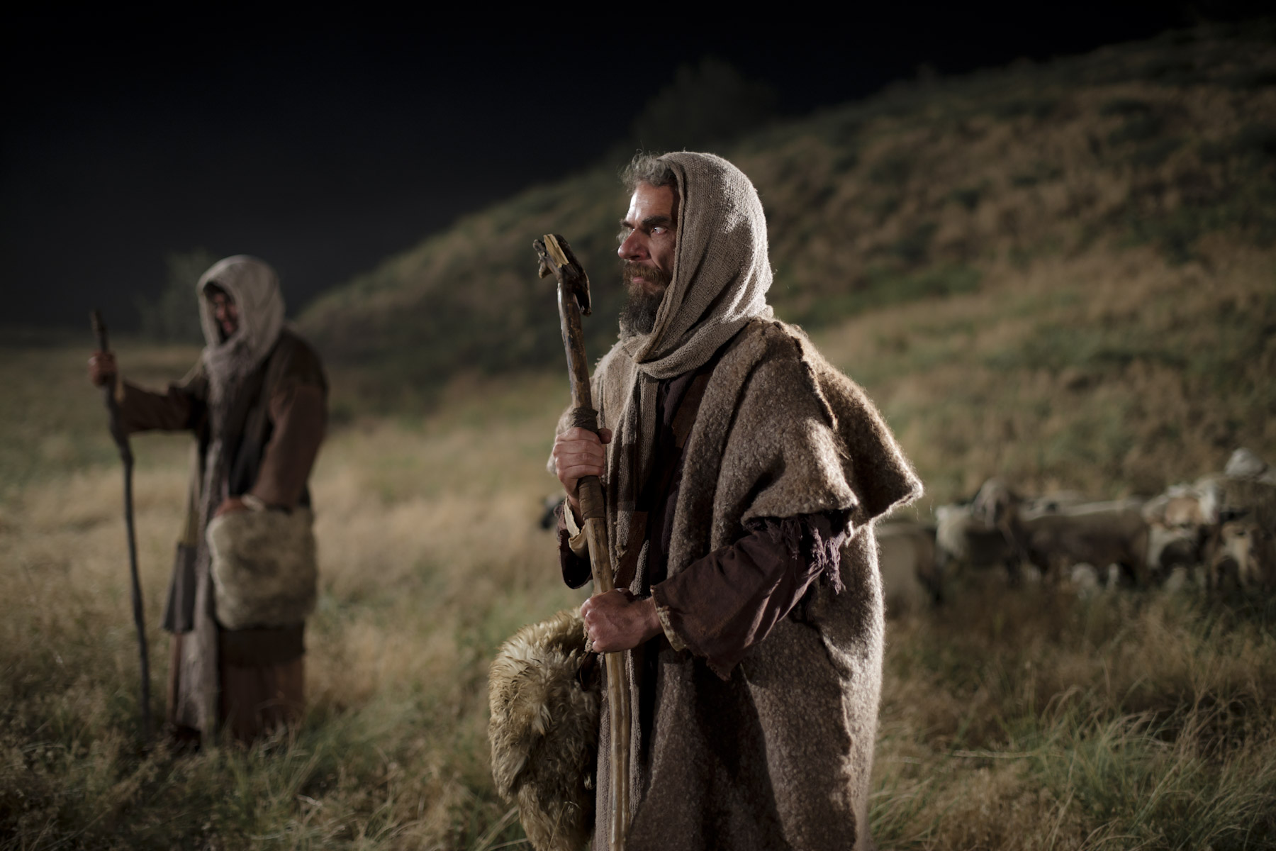

Slide 3
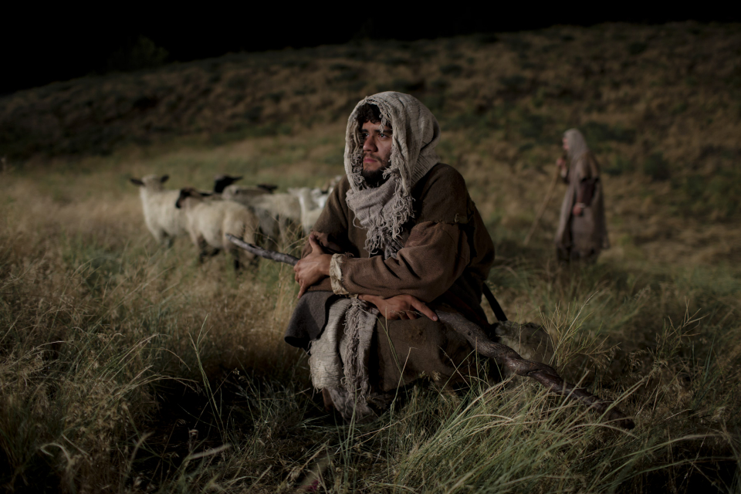

Slide 4
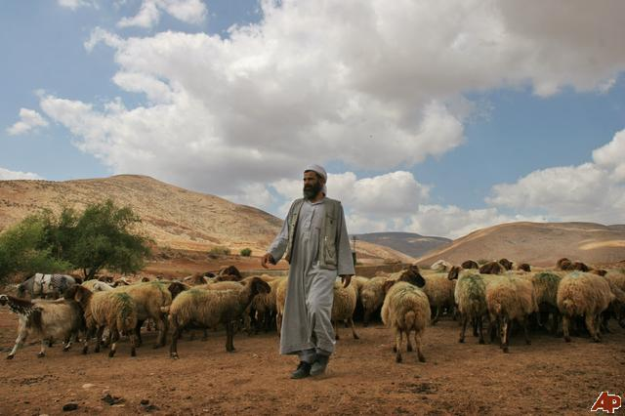

Slide 5
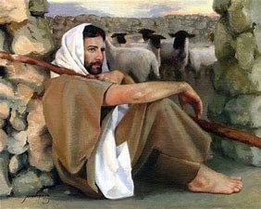

Slide 6
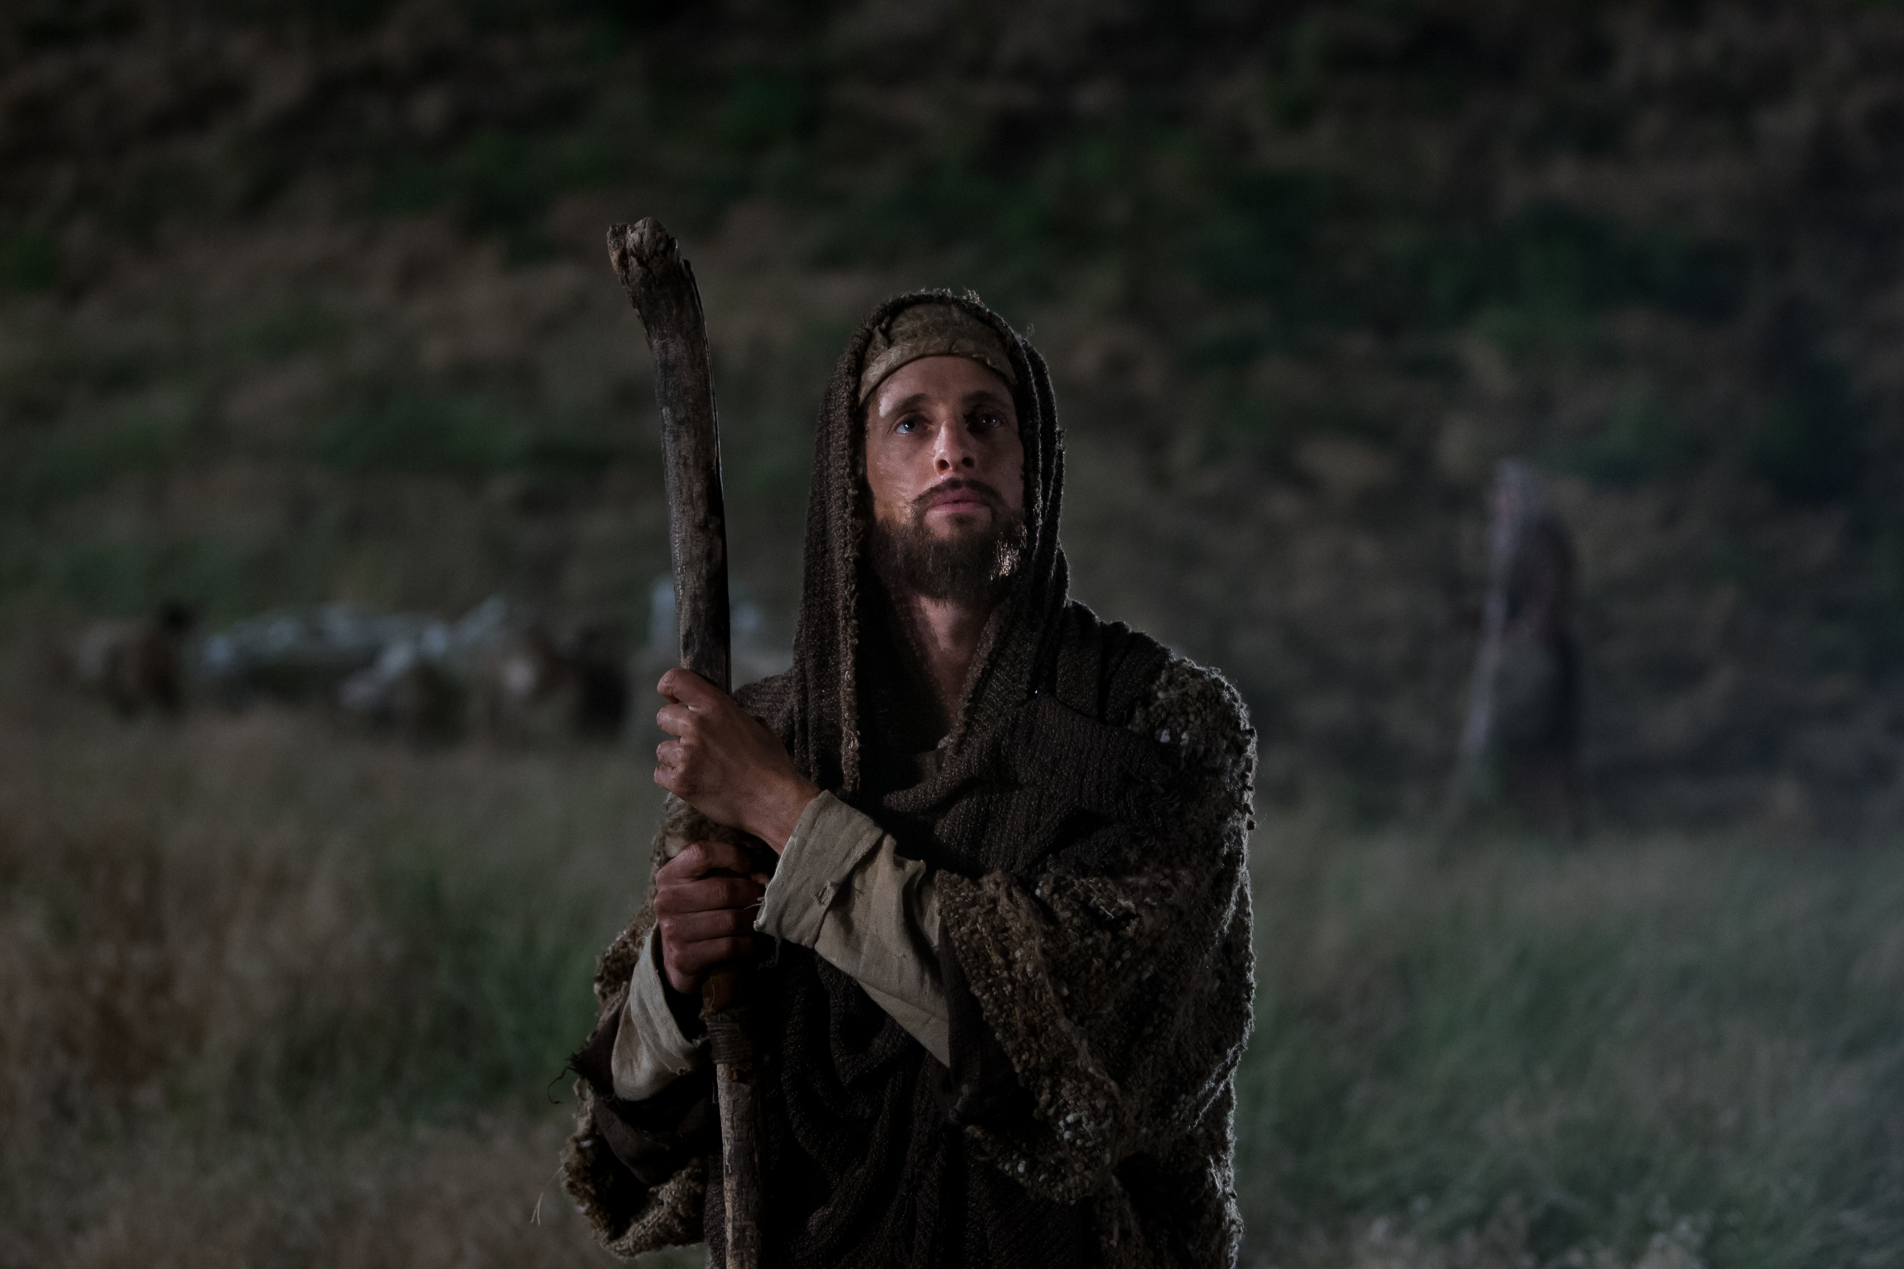

Slide 7
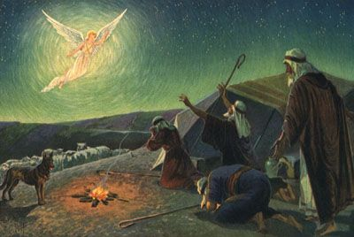

Slide 8
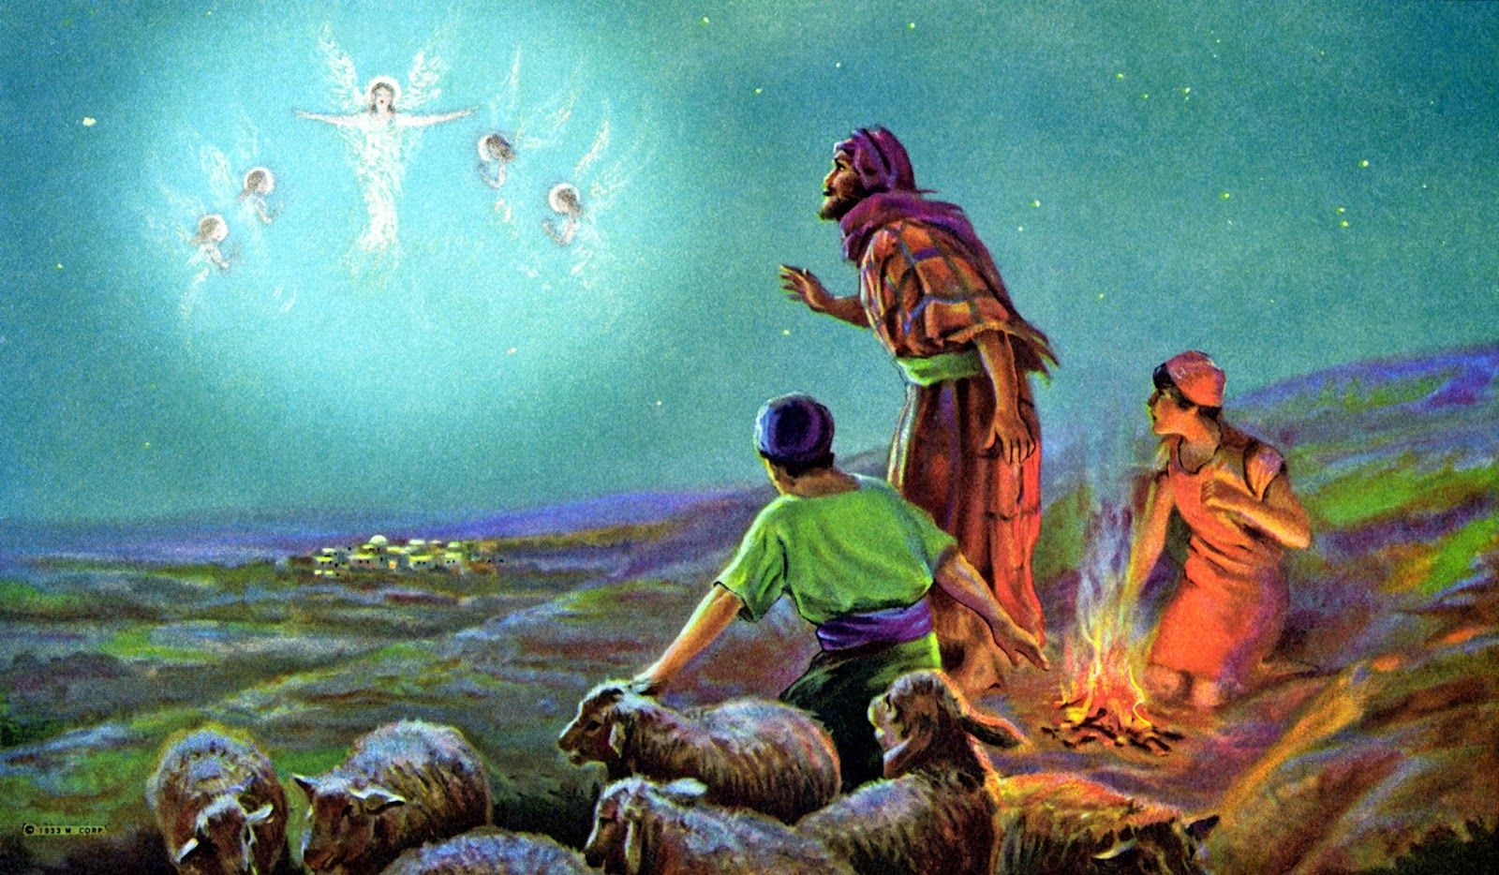

Slide 9
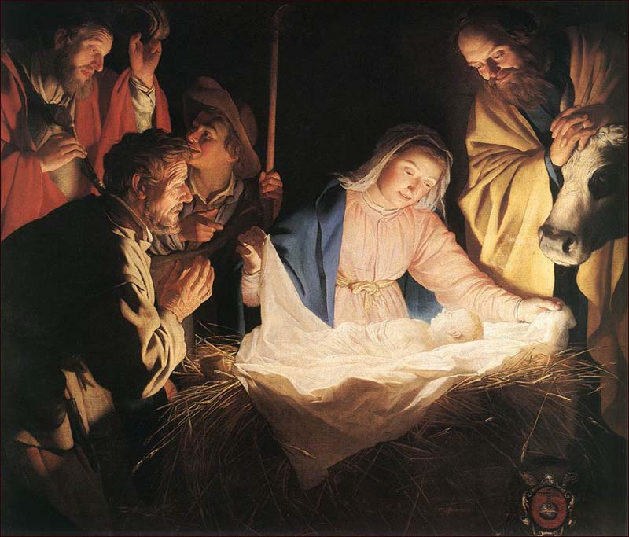

Slide 10
