Slide 1
King Herod
Teacher notes:
What do the paintings tell us about the type of person King Herod?

Slide 2
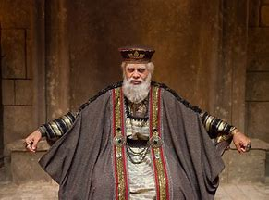

Slide 3
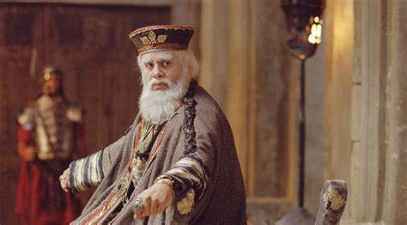

Slide 4
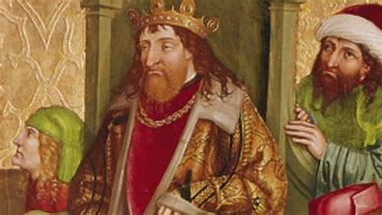

Slide 5
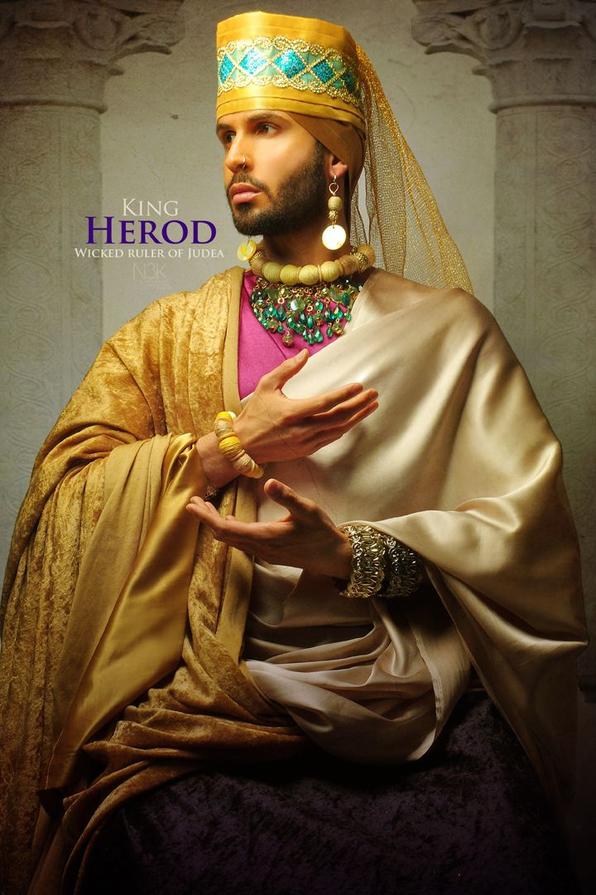

Slide 6
